Slide 1
CS5542: Big Data Analytics and Apps K-Means & EM Clustering
References: J. Han and M. Kamber, Data Mining: Concepts and Techniques
M. Dunham, Data Mining: Introductory and Advanced Topics

Slide 2
What’s Clustering
Organizes data in classes based on attribute values. (unsupervised classification)
Minimize inter-class similarity and maximize intra-class similarity
Comparison
Classification: Organizes data in given classes based on attribute values. (supervised classification) Ex: classify students based on final result.
Outlier analysis: Identifies and explains exceptions (surprises)

Slide 3
Example: Clustering
Income | Age | Children | Marital Status | Education
$25,000 $15,000 | 35 25 | 3 1 | Single Married | High School High School
$20,000 $30,000 | 40 20 | 0 0 | Single Divorced | High School High School
$20,000 | 25 | 3 | Divorced | College
$70,000 $90,000 | 60 30 | 0 0 | Married Married | College Graduate School
$200,000 $100,000 | 45 50 | 5 2 | Married Divorced | Graduate school College
Young & high school
Young & high school &
No children
Children and college degree
Higher incomes and degree
Higher incomes & degree &
Children

Slide 4
Quality of Clustering
A good clustering method will produce high quality clusters with
high intra-class similarity
low inter-class similarity
The quality of a clustering result depends on both the similarity measure used by the method and its implementation.
The quality of a clustering method is also measured by its ability to discover some or all of the hidden patterns.

Slide 5
Clustering & Similarity Measures
Definition: Given a set of n objects {X₁,…,X_{n}}, each represented by a p-dimensional vector on m attributes X_{i} = {x_{i1}, …,x_{ip}}, find k clusters classes such that the interclass similarity is minimized and intra-class similarity is maximized.
Distances are normally used to measure the similarity or dissimilarity between two data objects
Minkowski distance:
where i = (x_{i1}, x_{i2}, …, x_{ip}) and j = (x_{j1}, x_{j2}, …, x_{jp}) are two p-dimensional data objects, and q is a positive integer
Manhattan distance
where q= 1
Euclidean distance
where q= 2

Slide 6
Major Clustering Approaches
Partitioning algorithms: Construct various partitions and then evaluate them by some criterion (k-means, k-medoids)
Hierarchy algorithms: Create a hierarchical decomposition of the set of data objects using some criterion (agglomerative, division)
Density-based: based on connectivity and density functions
Grid-based: based on a multiple-level granularity structure
Model-based: A model is hypothesized for each of the clusters and the idea is to find the best fit of that model to each other

Slide 7


Partitioning: K-means Clustering
Basic Idea (MacQueen’67):
Partitioning (k cluster center means to represent k cluster and assigning objects to the closest cluster center) where k is given
Similarity measure using Euclidian distance
Goal:
Minimize squared error
where C(X_{i}) is the closest center to X_{i} and d is the squared Euclidean distances between each element in the cluster and the closest center
Algorithm:
Step 1: Select an initial partition of k clusters
Step 2: Assign each object to the cluster with the closest center
Step 3: Compute the new centers of the clusters
Step 4: Repeat Step 2 and until no object changes cluster

Slide 8
The K-Means Clustering Method
Example
10
10
9
9
8
8
7
7
6
6
5
5
4
Assign each objects to most similar center
Update the cluster means
4
3
3
2
2
1
1
0
0
0
1
2
3
4
5
6
7
8
9
10
0
1
2
3
4
5
6
7
8
9
10
reassign
reassign
K=2
Arbitrarily choose K object as initial cluster center
Update the cluster means

Slide 9
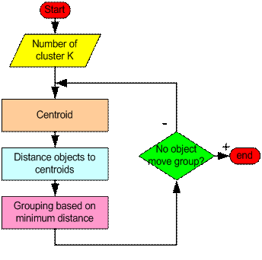
K-Means Clustering
Iterate until stable (= no object move group):
Determine the centroid coordinate
Determine the distance of each object to the centroids
Group the object based on minimum distance

Slide 10
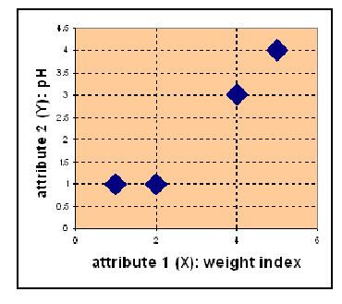
Example: K Means Clustering (k = 2)
Object att1 att2
Med-A 1 1
Med-B 2 1
Med-C 4 3
Med-D 5 4

Slide 11

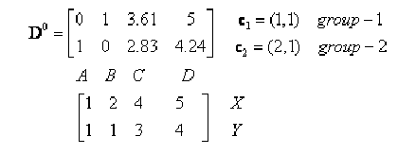


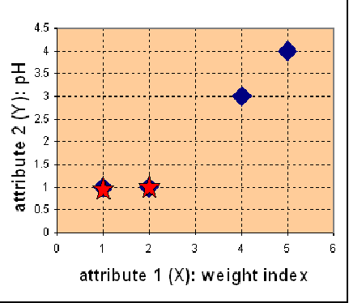
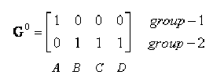
Iteration 0:
Centroid coordinate
Objects-Centroids distance
Objects clustering

Slide 12

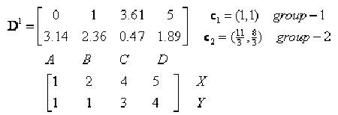
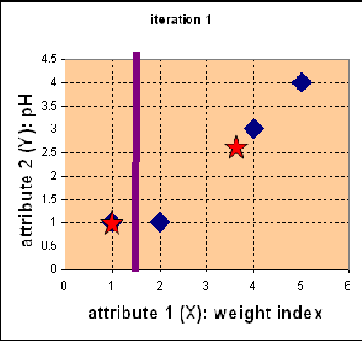
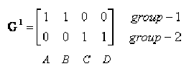
Iteration 1:
S1: Centroid coordinate
S2: Objects-Centroids distance
S3: Objects clustering

Slide 13
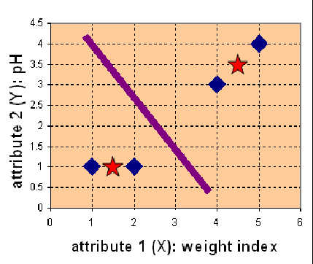


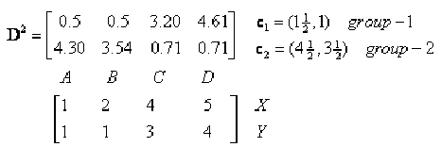
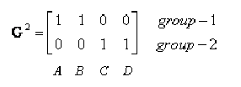
Iteration 2:
S1: Centroid coordinate
S2: Objects-Centroids distance
S3: Objects clustering
G¹ = G². so terminate the iteration

Slide 14
Limitations: K-means Clustering
Limitations:
The k-means algorithm is sensitive to outliers since an object with an extremely large value may substantially distort the distribution of the data.
Applicable only when mean is defined, then what about categorical data?
Need to specify k, the number of clusters, in advance
A few variants of the k-means which differ in
Selection of the initial k means
Dissimilarity calculations
Strategies to calculate cluster means
PAM (Partitioning Around Medoids, 1987): Instead of taking the mean value of the object in a cluster as a reference point, medoids can be used, which is the most centrally located object in a cluster.

